Slide 1
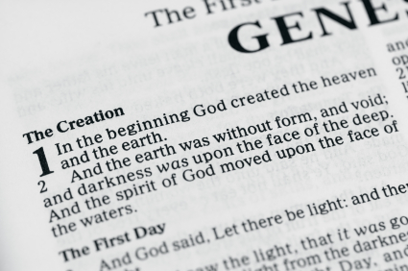
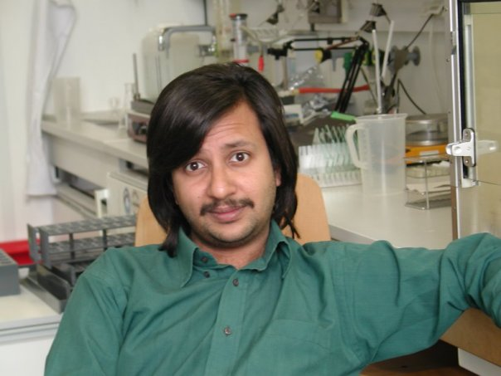
The Genesis of Genetics
Dr. Arnab Ganguli
BB College Asansol
66th OP HRDC JU

Slide 2
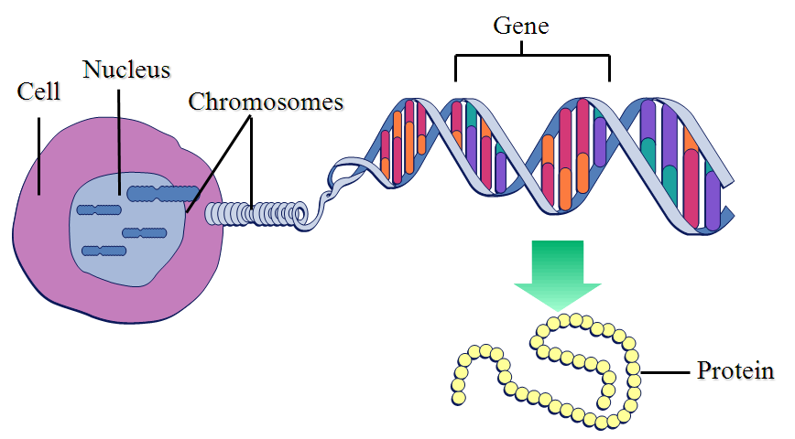
How do I define Gene and Genetics
Segment of DNA
Unit of Heredity
Transmitted by laws
If inheritance
Codes for traits
Mainly in the form of
Protein
A gene is expressed
and regulated
Genetics is the study of genes, genetic variation, and heredity in living organisms.

Slide 3
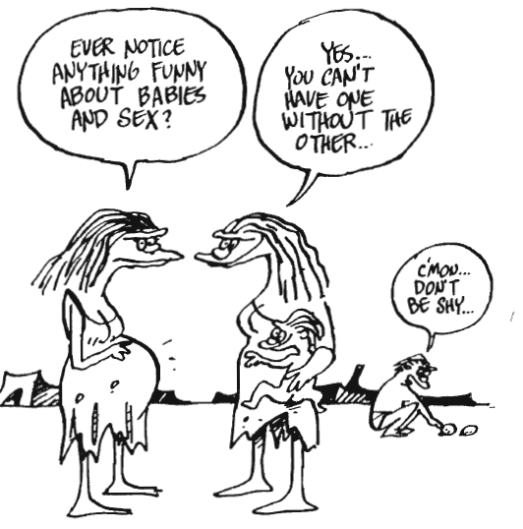
Reproduction – The Motivation
Behind Genetics
Or the link between Sex and Reproduction
Our Primitive ancestor may have had
Not known about the link between
Sex and Reproduction
The 9 months difference between
Sex and Reproduction was too much
To correlate .
It was also a challenge for them to
Find that living beings reproduced
And not living did not.
Anything that moved was considered
Living

Slide 4
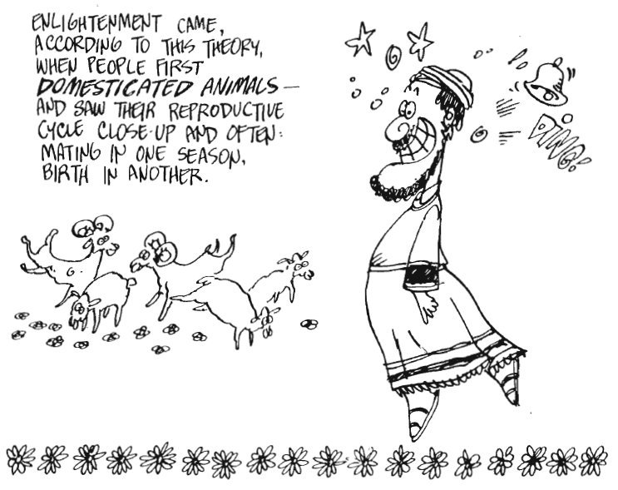
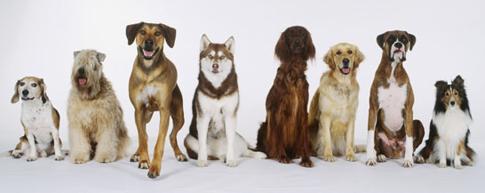
Enlightment
Or Domestication of animals and Like begets Like
Along with it came the theory
LIKE BEGETS LIKE
And Also started SELECTIVE
BREEDING
AND THUS THE INTEREST IN THE LAWS OF HEREDITY BEGAN

Slide 5
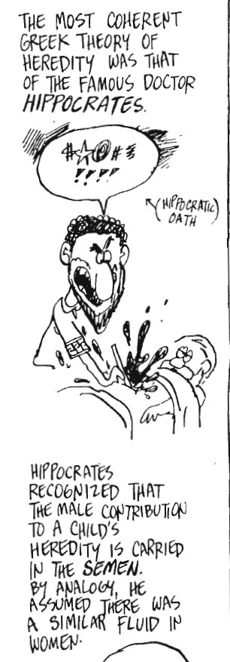
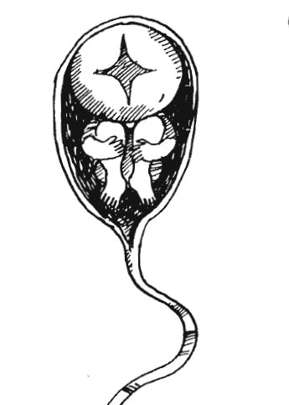
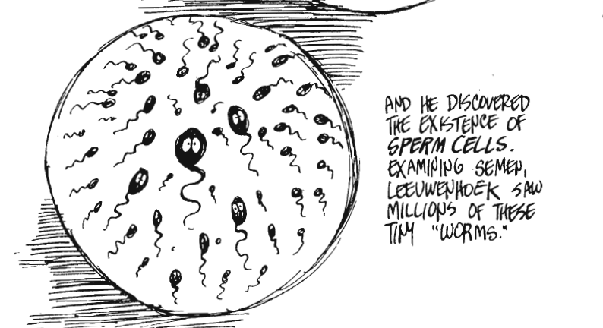
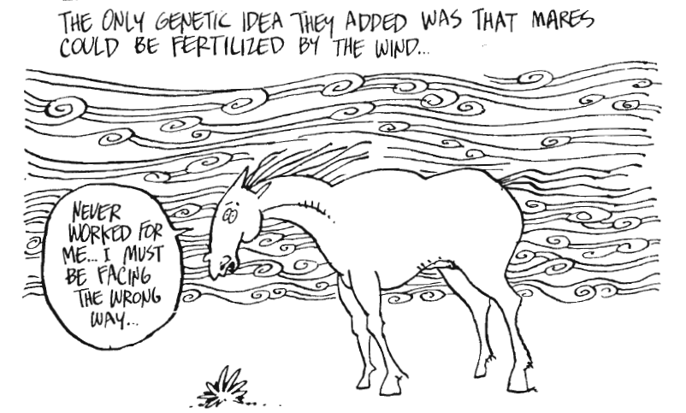
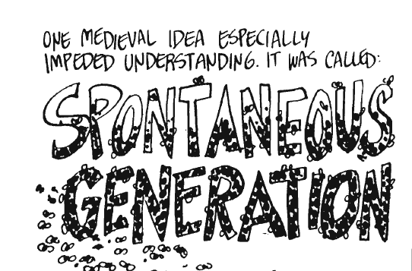
Of Philosophy and Magic
From Hippocrates to Leeuwenhoek
Anton van Leeuwenhook
That insects were also sexual beings
Created a lot of controversy in church

Slide 6
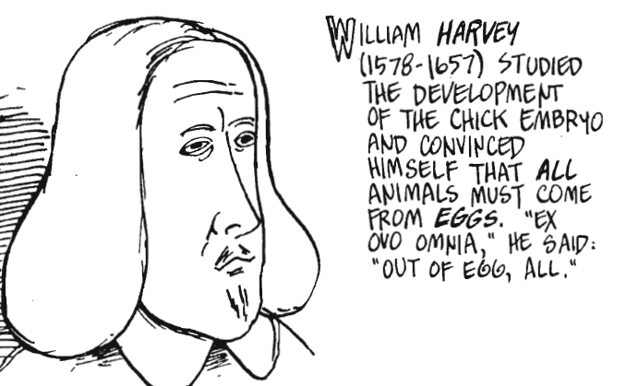
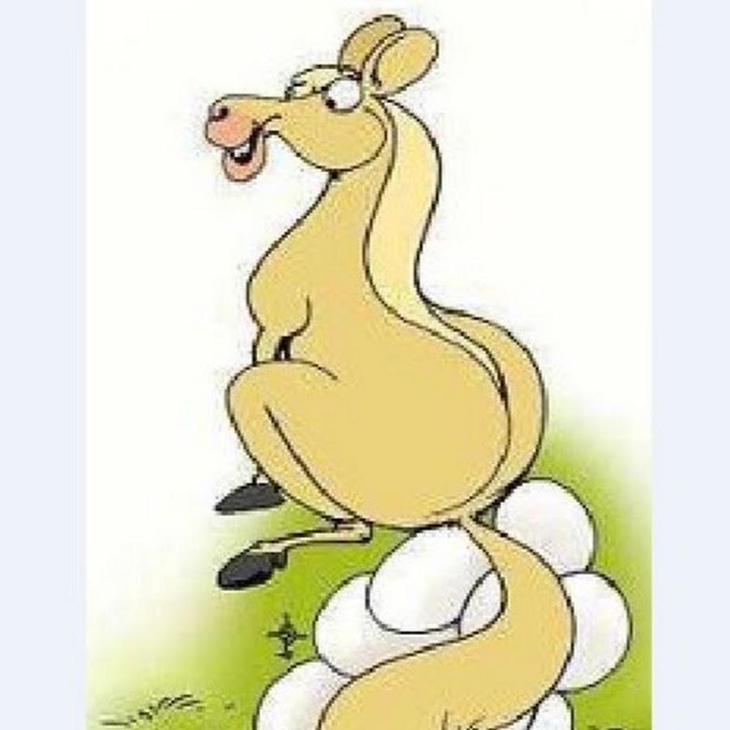
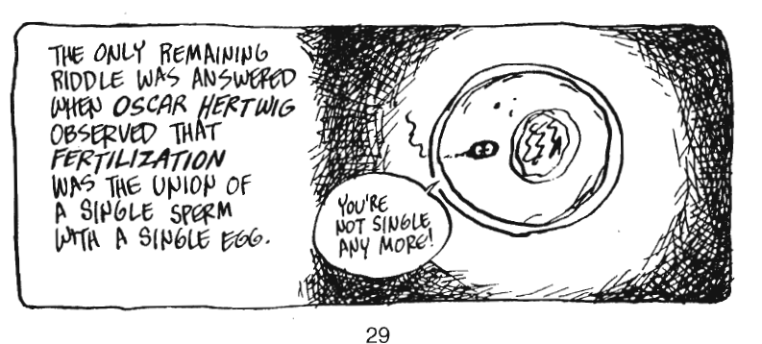
In Search of the Magical Egg

Slide 7
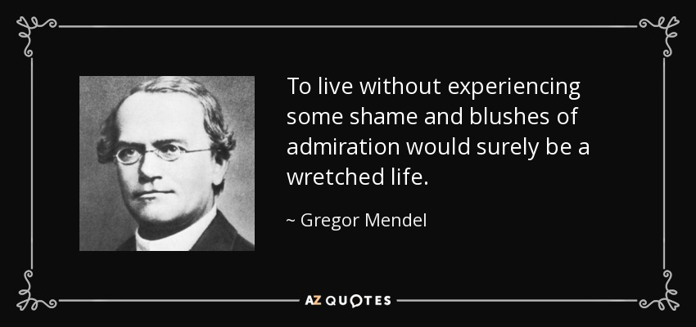
The Father of Genetics

Slide 8
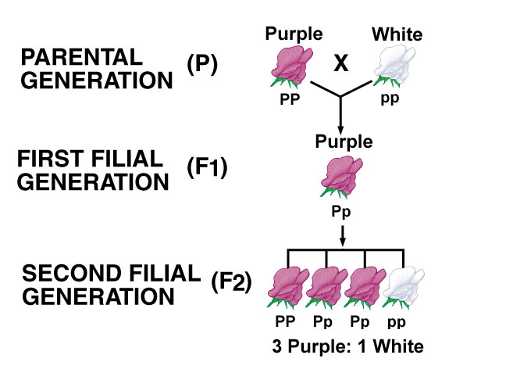
The Lord and his Pea Power
Law of Dominance
Law of Segregation
Law of Independent Assortment
My scientific studies have afforded me great gratification; and I am convinced that it will not be long before the whole world acknowledges the results of my work.
Gregor Mendel

Slide 9
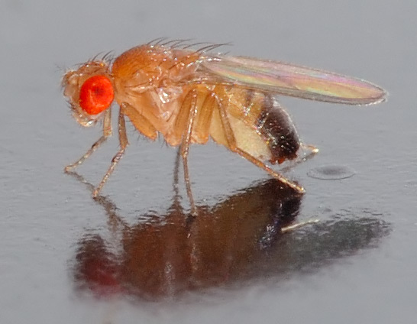
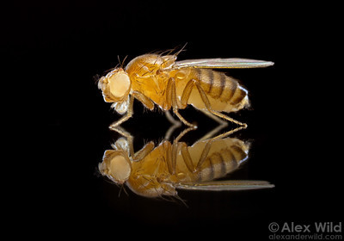
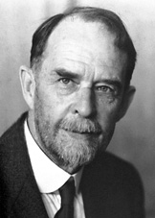
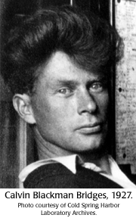
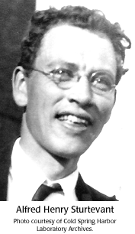
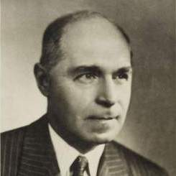
The Famous Fly Room
Genes are located on Chromosomes
And the physical Basis of inheritance
Molecular Basis of Mutation
Linkage and Crossing over
And gene mapping

Slide 10
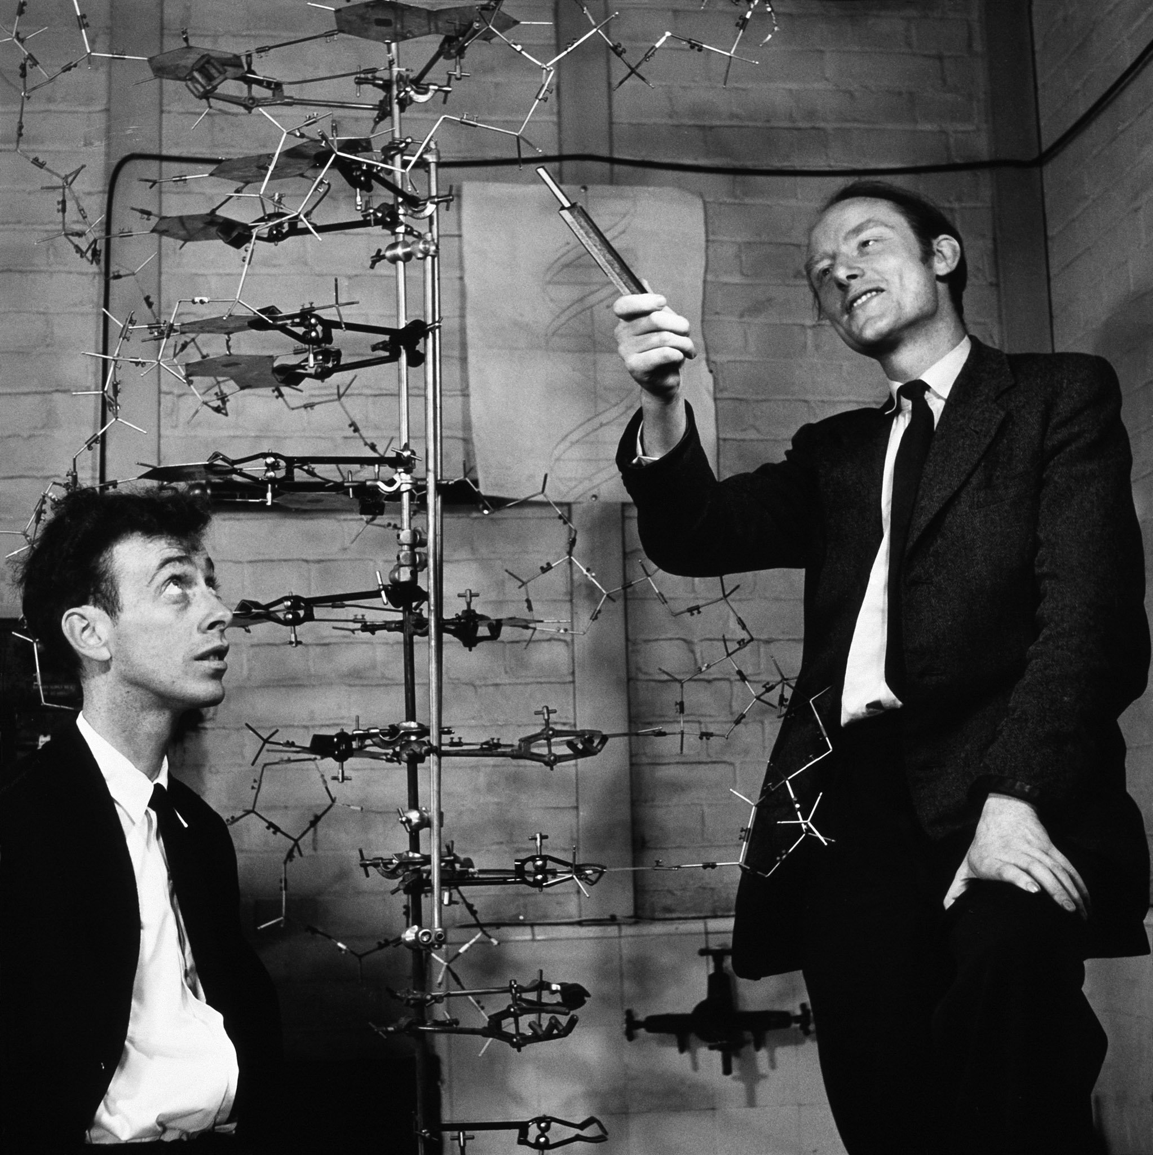
The Double Helix and later Advances
Human Genome Project
Age of Functional Genomics
1953 Double Helical Structure
Of DNA

Slide 11
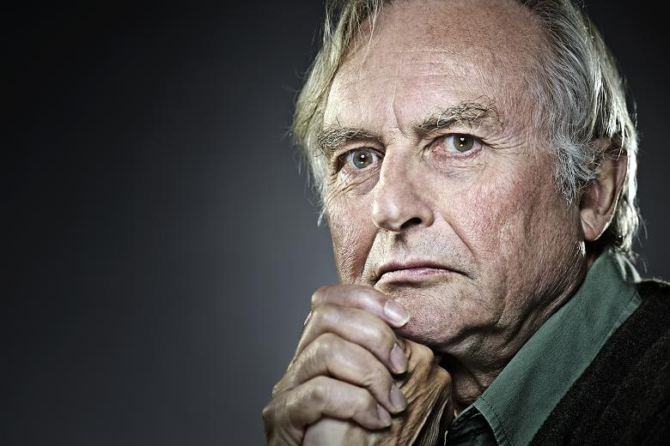
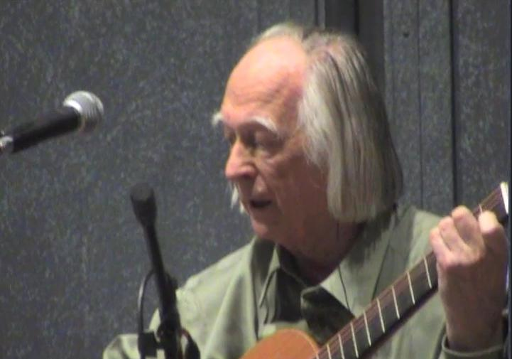
Vindication or Victimization
Current Status
The Selfish Gene
The Music of Life
Father of Systems
Biology
“(Genes) swarm in huge colonies, safe inside gigantic lumbering robots, sealed of from the outside world, communicating with it by tortous indirect routes , manipulating it by remote control. They are in you and me ; they created us, body and mind; and their preservation is the ultimate rationale for our existance. ― Richard Dawkins, The Selfish Gene
“(Genes) are trapped in huge colonies, locked inside highly intelligent beings, moulded by the the outside world, communicating with it by a complex process , through which as if by magic function emerges. They are in you and me ; we are the system that allows their code to be read; and their preservation is totally dependent on the joy we experience in reproducing ourselves. We are the ultimate rationale for our existance. ― Denis Noble, The Music of Life

